Slide 1

Scientific Calculator Development
A Python GUI application for standard and scientific mathematical calculations
Submitted By: Abhisek Hota
Domain: Python GUI Application
Internship Project: NextHikes IT Solutions
Technology: Python 3.x with tkinter

Slide 2

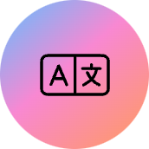
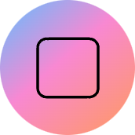


About The Project
Language
GUI Framework
Python 3.x for robust application development
tkinter - Native Python GUI toolkit for desktop applications
Math Library
Python's standard math module for scientific calculations
Calculator.py combines Python's powerful math capabilities with an intuitive graphical interface, creating a functional desktop application for both basic and advanced mathematical operations.

Slide 3
Development Process
01
02
03
GUI Setup
Layout Design
Core Logic
Created main window using Tk() and display entry field. Used StringVar to link expression string to the display.
Organized buttons with grid layout manager. Configured grid weights for uniform button sizing across rows and columns.
Implemented button_click(char) to build expression strings dynamically as users interact with buttons.
04
05
Secure Evaluation
Error Handling
Used eval() with restricted environment {"__builtins__": None} for security when processing calculations.
Applied try-except blocks to catch ValueError and mathematical domain errors gracefully.

Slide 4

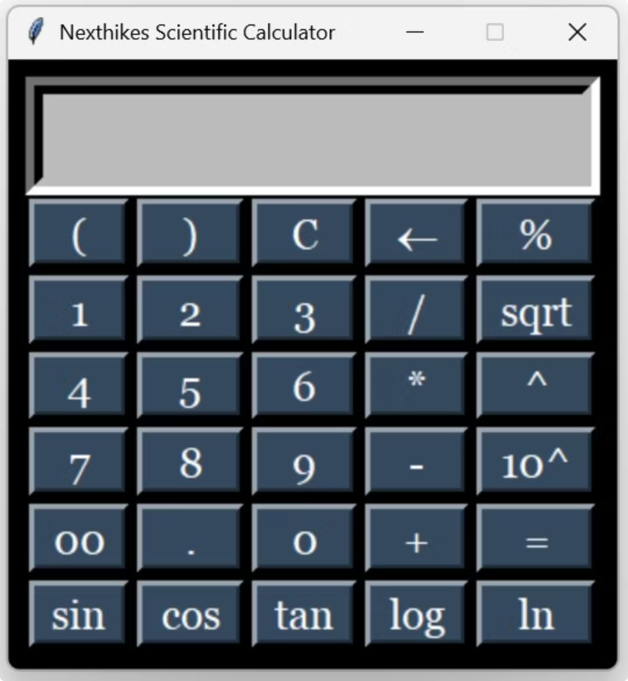

Application Output
User Interface Features
Example Calculation
Simple, dark-themed interface built with tkinter widgets
sin(90) + log(100)
Responsive layout adapts button sizes for consistent appearance
Handles complex expressions with parentheses and multiple operators
= 1.0 + 2.0
= 3.0
Supports scientific functions seamlessly

Slide 5

Source and Reference
Python 3.x Documentation
Primary source for language syntax and programming paradigms
tkinter Documentation
Reference for widgets, layout management, and GUI components
Math Module
Python's standard mathematical library for scientific functions
Design Principles
Object-oriented and functional programming paradigms in Python
Additional reference: GeeksforGeeks Python GUI Calculator Tutorial

Slide 6

Summary and Conclusion
Project Success
Key Learning
Implemented full-featured scientific calculator using minimal external dependencies (tkinter, math)
Mastered tkinter.grid for complex layouts and implemented security constraints around dynamic code evaluation
Final Outcome
Robust, functional, self-contained application fulfilling internship goals

Slide 7
Thank You

